Slide 1


Slide 2




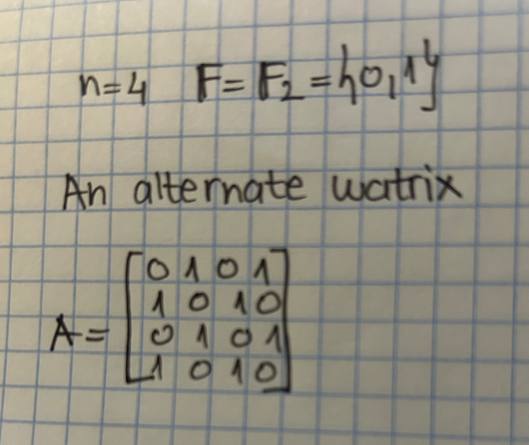
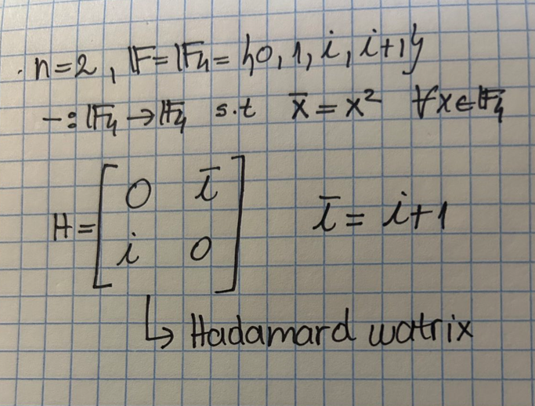

Slide 3








Slide 5


What if my determinant is not zero?

Slide 6






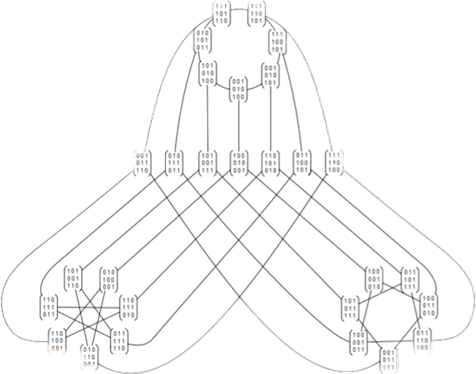

Slide 7
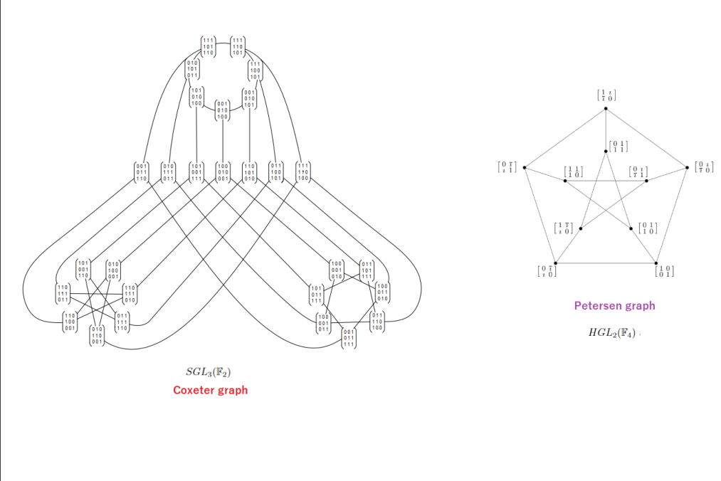

Slide 8

RESEARCH QUESTIONS

Slide 9



Slide 10



Slide 11

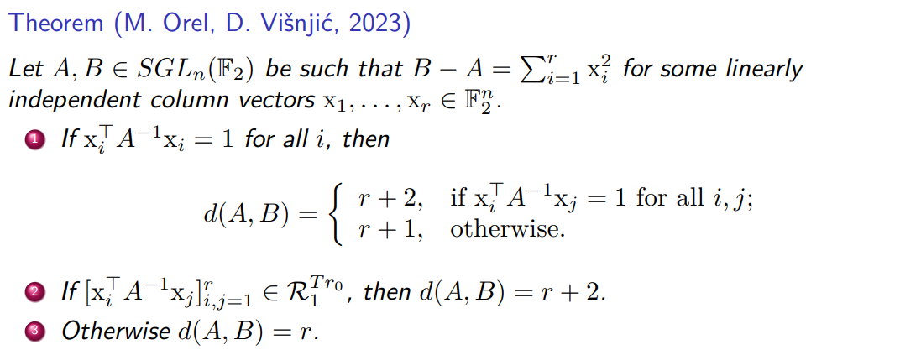

Slide 12



Slide 13


Slide 14
THANK YOU FOR YOUR ATTENTION!

